Slide 1
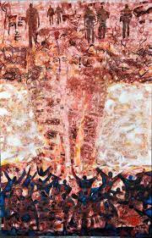
LXE-3011 Languages and Ecologies
Week 2
Lecture: Nuclear France, French nuclear imperialism
Seminar: Algerian and Polynesian anti-nuclear decolonial visual arts
Dr Armelle Blin-Rolland (a.blin-rolland@bangor.ac.uk)
Notes:
Artwork: Reggane, afin que nul n’oublie! by Lazhar Hakkar

Slide 2
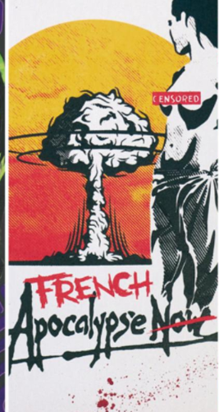
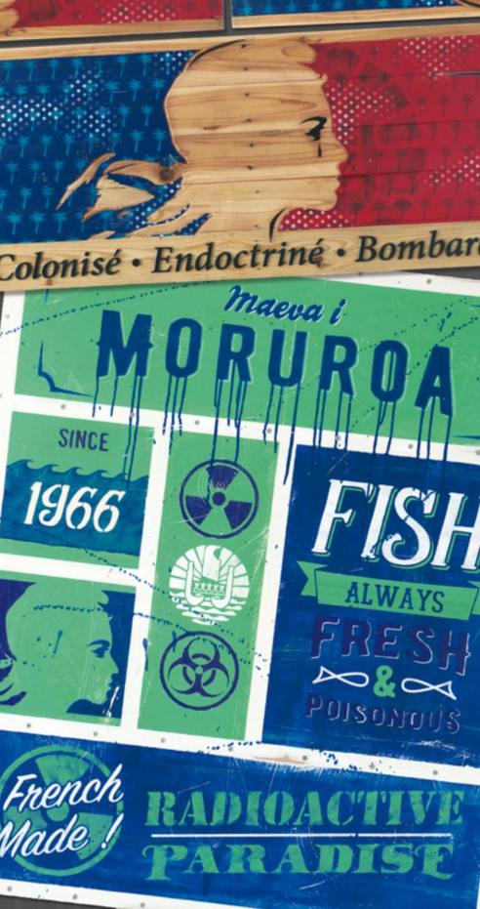
This week
Lecture:
Nuclear France, French nuclear imperialism
Seminar:
Algerian and Polynesian anti-nuclear decolonial visual arts
Notes:
Artwork 1 by Cronos
Artwork 2 by Cronos
Part of the collective exhibition Moruroa Forever, see exhibition catalogue at https://issuu.com/hennessy/docs/moruroa-web/1

Slide 3
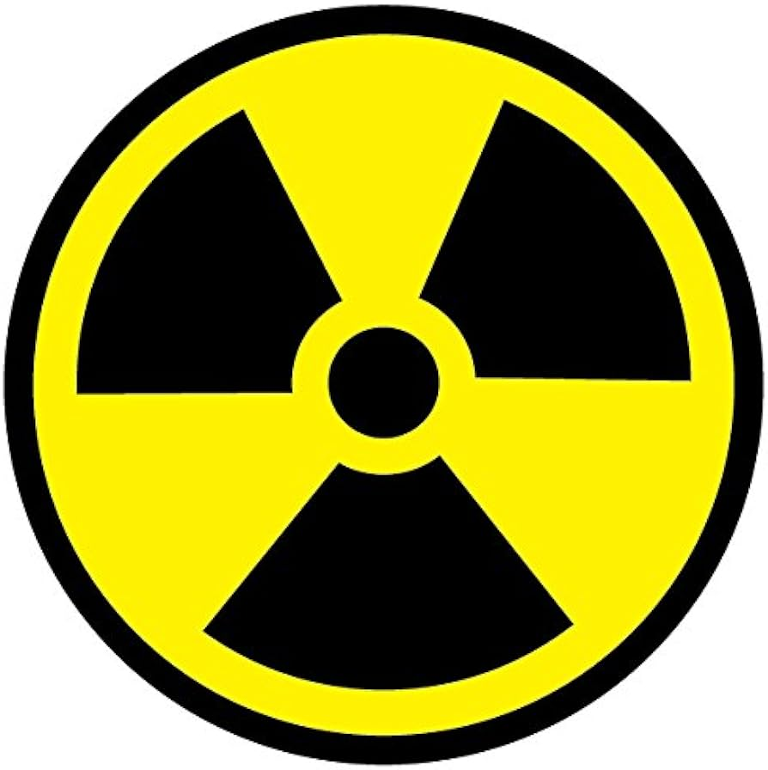
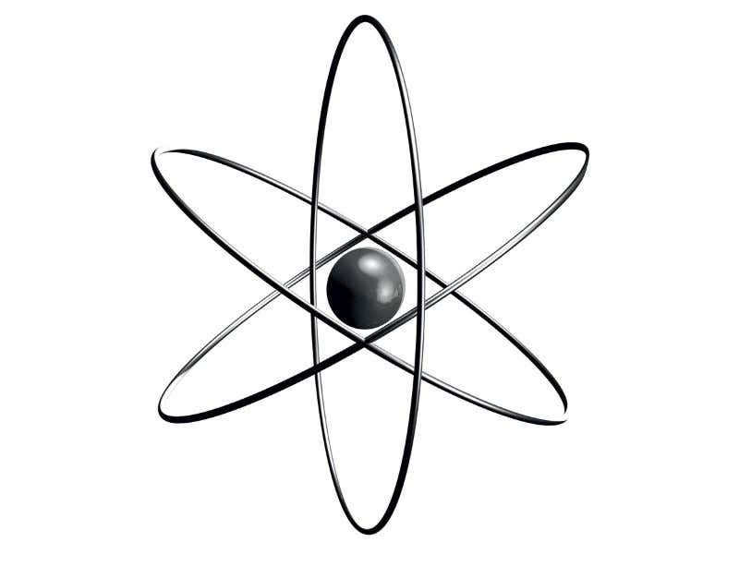
What is nuclear power?
Nuclear energy originates from the splitting of uranium atoms – this is called fission. This generates heat to produce steam, which is used by a turbine generator to generate electricity.
process of mining, milling, conversion, enrichment, fuel fabrication and electricity generation
‘The civil and military nuclear complexes are so closely interlinked that a uranium atom used in a nuclear plant may very well be reused in an atomic bomb created for the military’ (Maurer and Hogue 2020: 31)

Slide 4
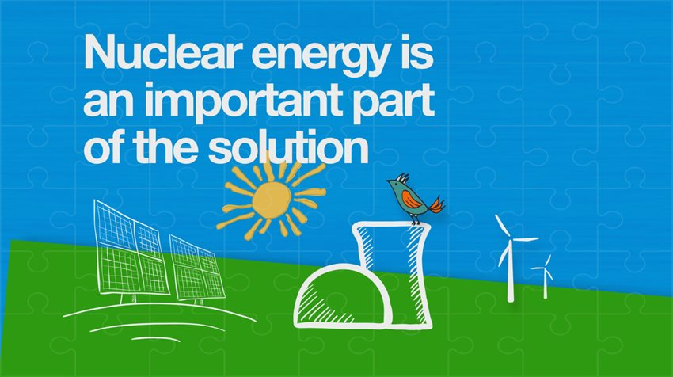
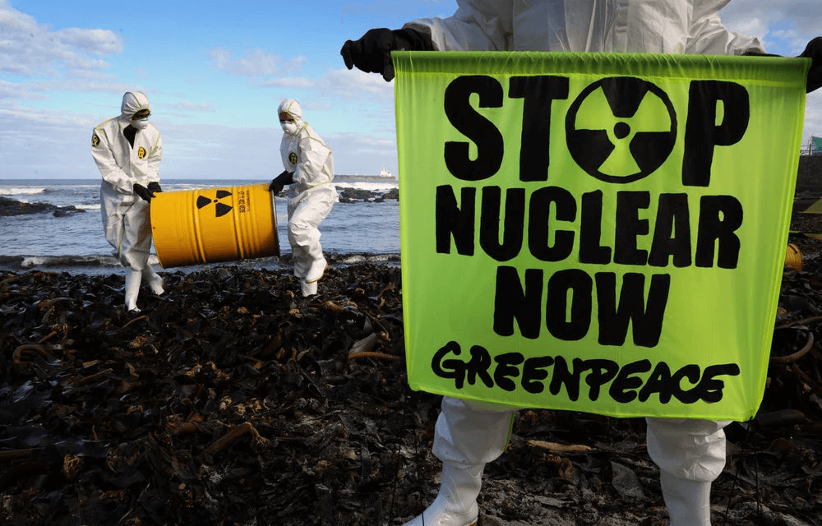
Nuclear energy and the climate emergency
Because nuclear power plants do not burn fuel, they do not produce greenhouse gas emissions.
But the nuclear is not a zero-emissions energy source when we take the whole cycle into account (extraction, transport, construction, demolition, decommission of power plants, transport and storage of waste)
Compare points of view of e.g. Greenpeace and the World Nuclear Association
Notes:
Source for image 1: https://world-nuclear.org/nuclear-essentials/how-can-nuclear-combat-climate-change.aspx
Source for image 2: https://www.forbes.com/sites/brentanalexander/2021/08/15/the-ipcc-climate-report-outlines-an-alarming-future-avoiding-the-worst-means-trying-everything/?sh=18ae33b9240b

Slide 5
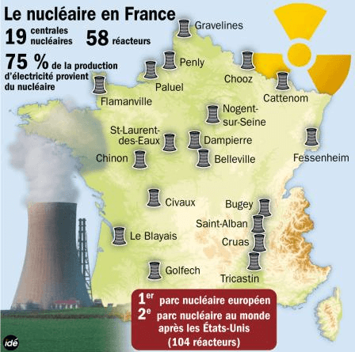
France as a nuclear power
France has one of the largest nuclear power programs in the world
derives over 75% of its electricity from nuclear energy.
France has conducted 210 (approx.) nuclear tests since 1960 (US: 1,054; Britain: 45; China: 47; Soviet Union: 715)
Notes:
Image source:
https://www.francetvinfo.fr/economie/nucleaire-les-centrales-francaises-ne-sont-pas-a-labri-dun-cumul-d-incidents_1654421.html

Slide 6
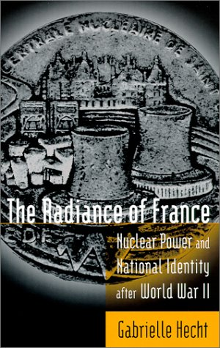
Nuclear France
The ‘radiance’ of France
The word ‘rayonnement’ – which in French means both radiation and grandeur – has been consistently and repeatedly used by French Presidents since the 2nd half of the 20th century
National narrative of modernity and technological power in the context of France’s crumbling empire

Slide 7
The radiance of France – a national narrative
De Gaulle’s speech in Tahiti in 1966 as he launched the French nuclear trial programme in Polynesia:
  avec sa puissance renaissante, avec son rayonnement, avec sa politique, qui représente le progrès des hommes
  [France’s] reborn power, its radiance, its politics, that represent the progress of men
Macron’s speech in 2021 in Tahiti as he did not issue an official apology
  Cette stratégie indo-pacifique, elle est économique, elle est énergétique, elle est climatique, environnementale, politique et vous êtes au coeur de celle-ci. Elle est militaire et elle est de rayonnement.
  [France’s] Indo-Pacific strategy is economic, energetic, climatic, environmental, political and you [Polynesians] are at its heart. It is military and it is of radiance.

Slide 8
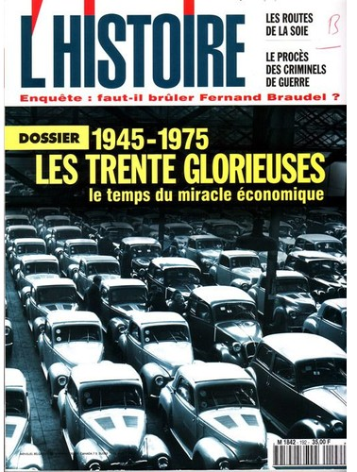
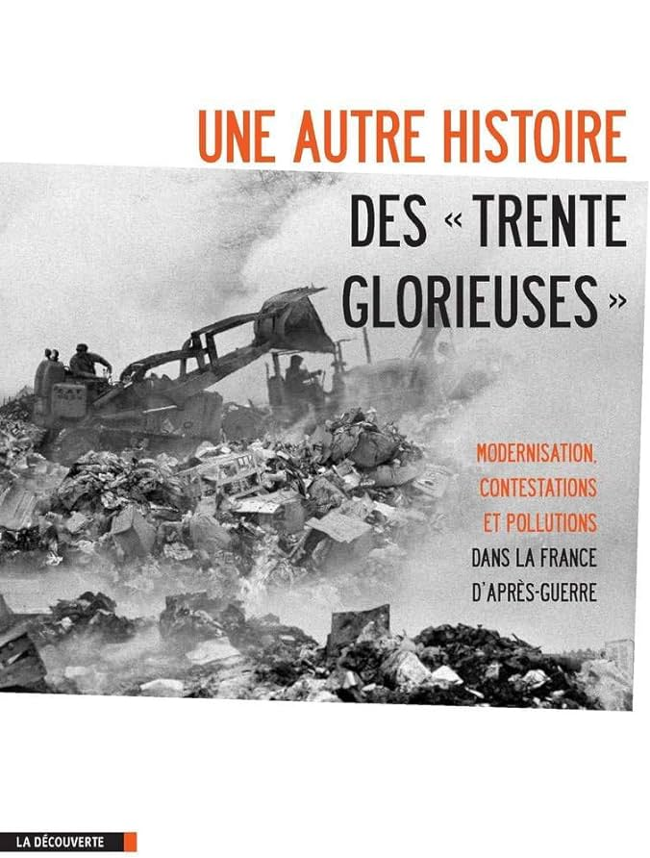
Les Trente Glorieuses / Les Trente Ravageuses
France’s period of ‘Les Trente Glorieuses’ – Thirty Glorious Years
May be better thought of as ‘Les Trente Ravageuses’ – Thirty Destructive Years
We will get back to this also in relation to factory farming & industrial slaughter, the development of which was also part of this era of modernisation

Slide 9

Nuclear as ‘clean’, ‘green’ energy

Slide 10

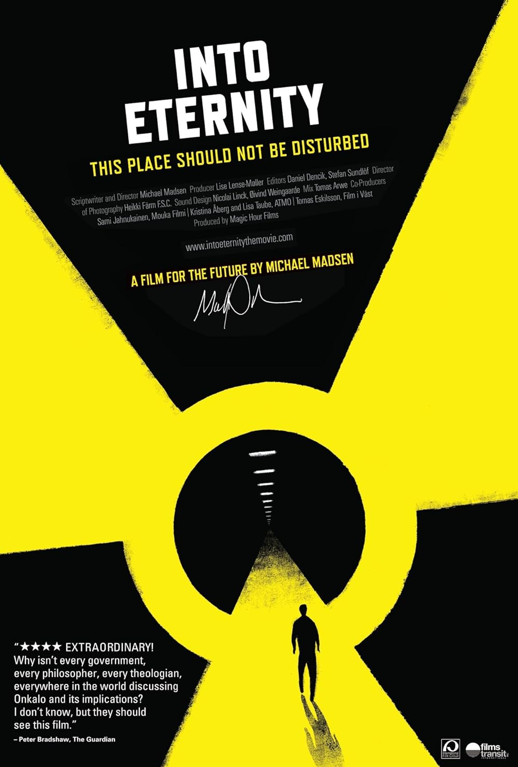
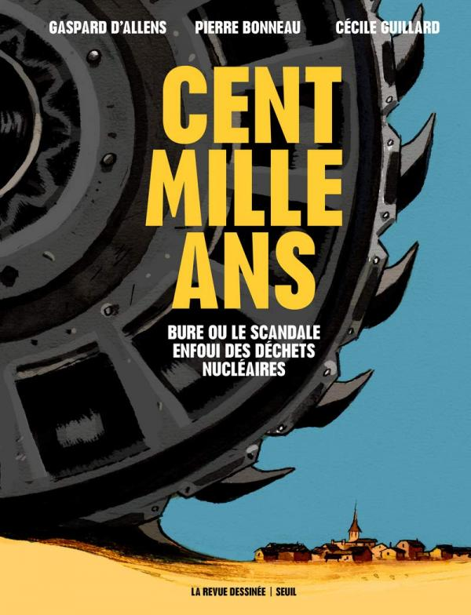
Nuclear as ‘clean’, ‘green’ energy
issue of extractivism (e.g. Niger)
issue of security and health & environmental impacts (ageing reactors)
issue of waste (100,000 years, Into Eternity)

Slide 11
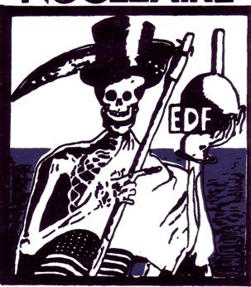
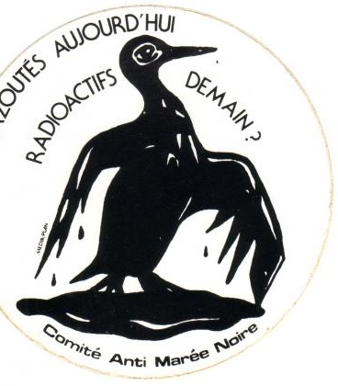
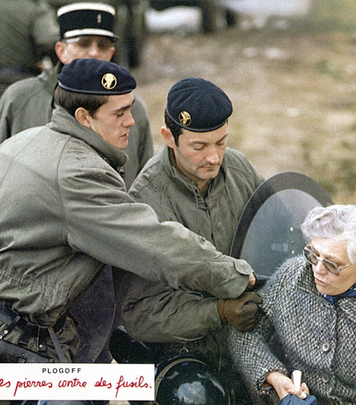
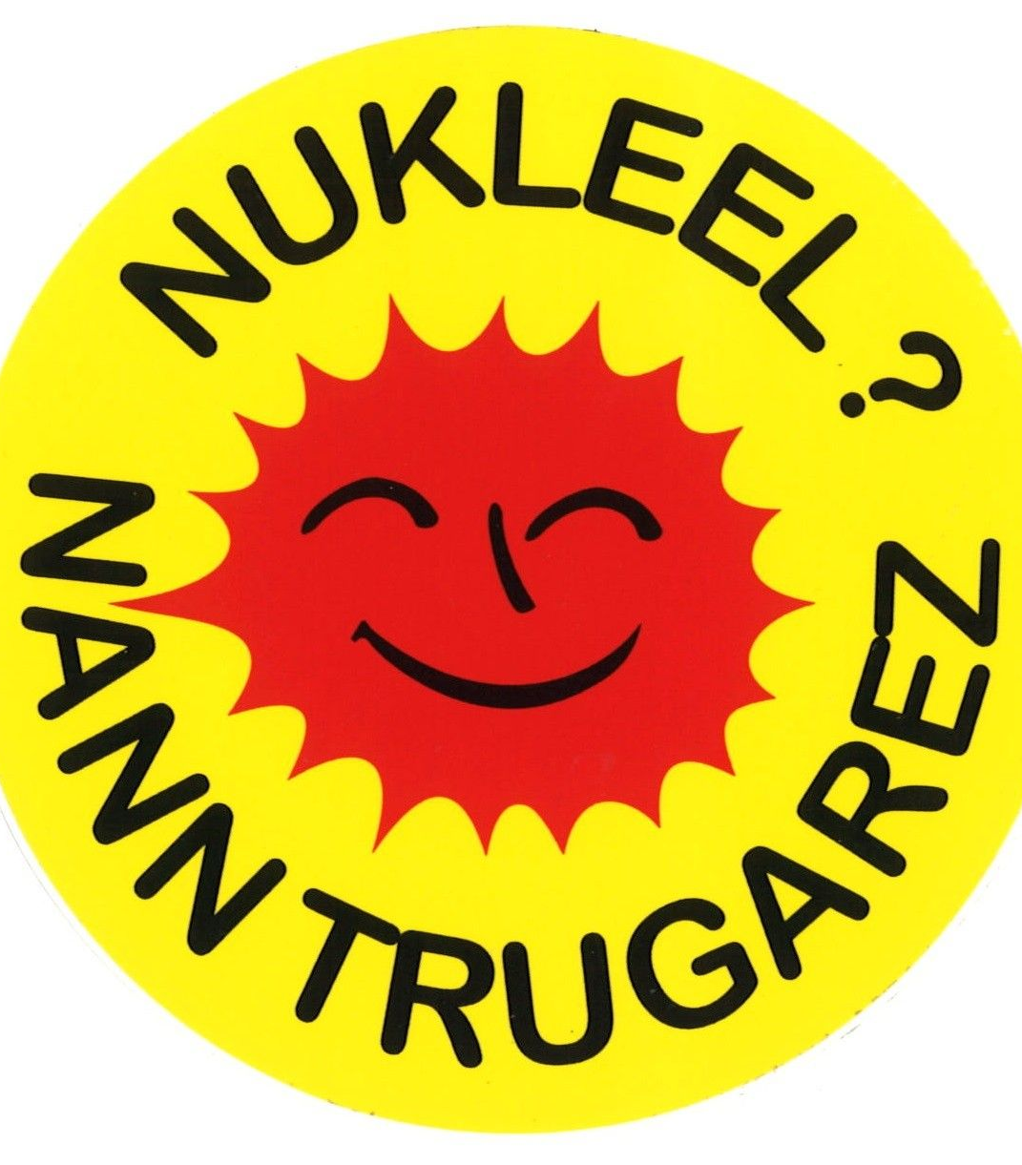
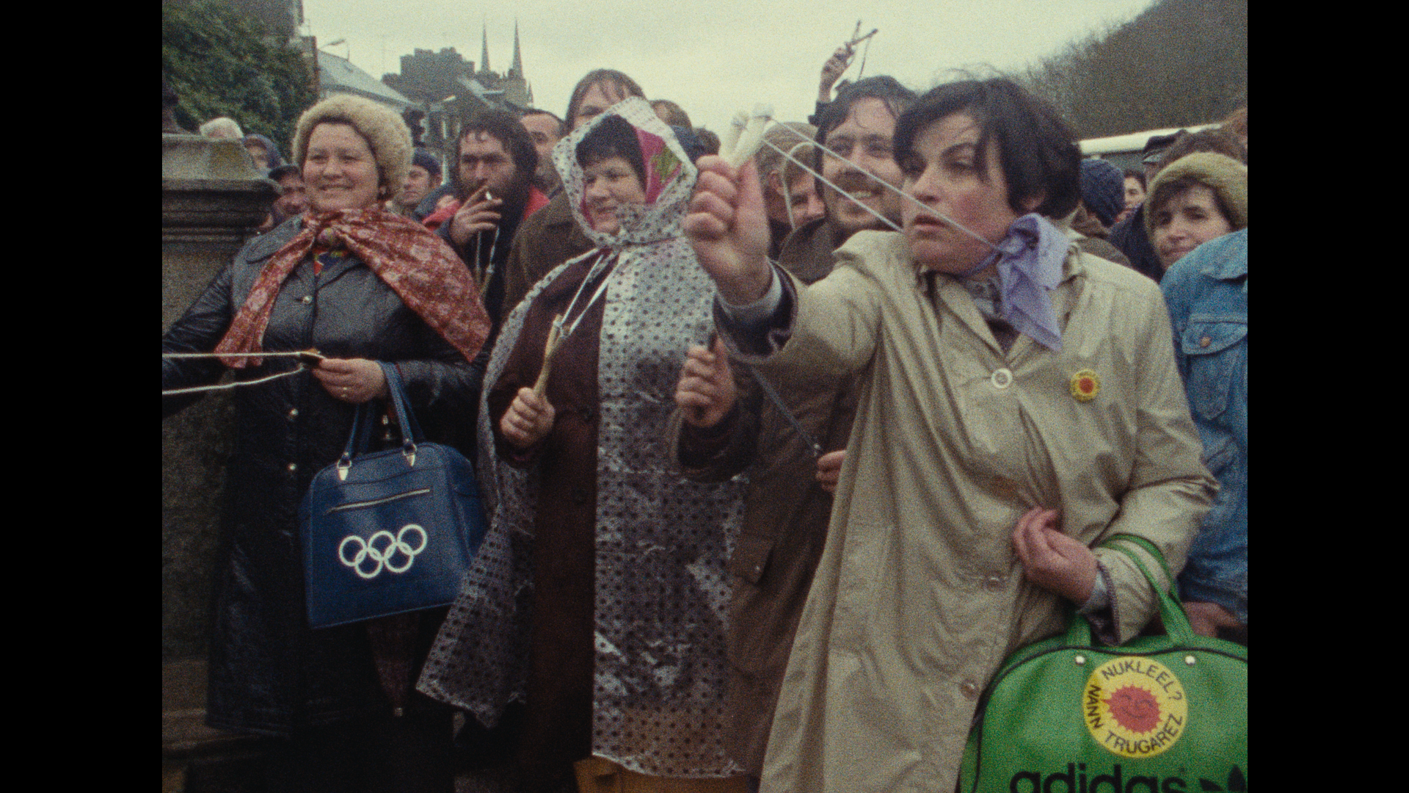
Anti-nuclear activism in the Hexagon: the case of Plogoff (Brittany)
https://www.ecomodlang.com/resources/plougon-plogoff/

Slide 12
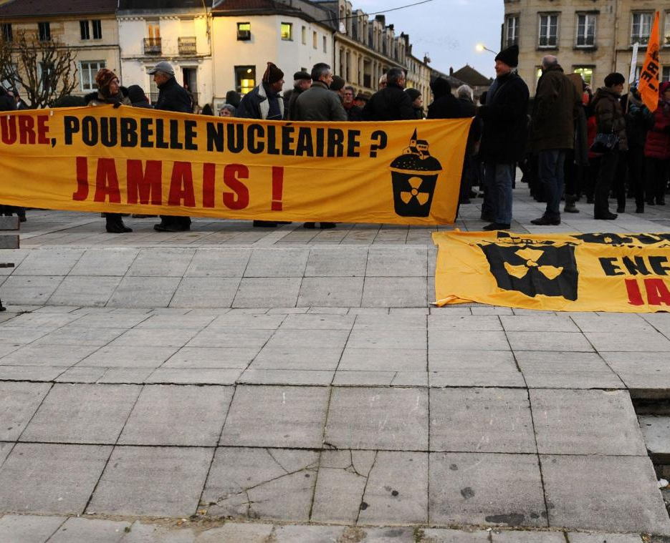
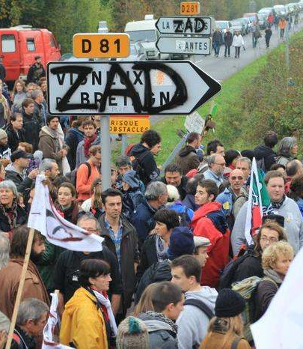
Anti-nuclear activism in the Hexagon: the case of Bure
Nuclear waste disposal project

Slide 13
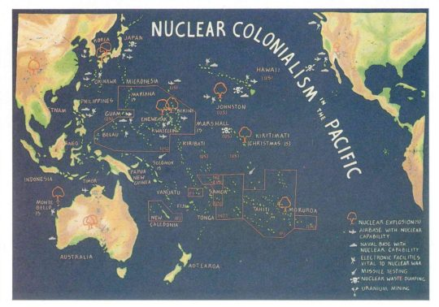
Nuclear colonialism / imperialism
We define nuclear imperialisms as the state-sponsored, systemic mode of oppression in current or former sites of empire through any use of the nuclear complex. (Maurer and Hogue 2020)
Nuclear colonialism is a system of domination through which governments and corporations disproportionately target and devastate indigenous peoples and their lands to maintain the nuclear production process. (Endres 2009)
Notes:
Image source: https://womenslibrary.org.uk/event/weaving-a-transoceanic-web-anti-nuclear-solidarities-between-greenham-women-and-indigenous-communities/

Slide 14
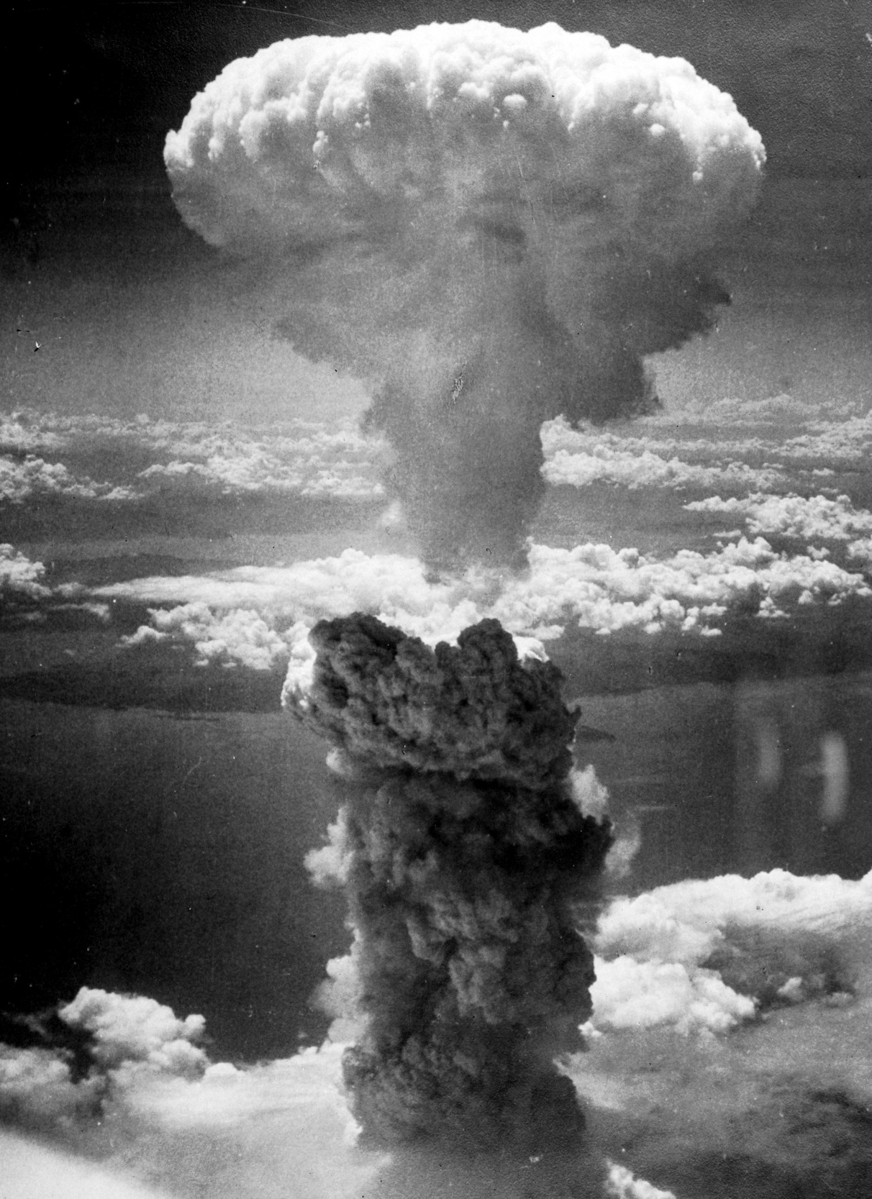
Nuclear imperialism
Nuclear countries do not develop and experiment their weapons of death on their own soils but on their colonies’ soils. Nuclear is happening because colonies exist. If French Polynesia was not a French colony, Jacques Chirac would not have possibility to resume French testing in my country. If French Polynesia and Marshall Islands were not colonies, Pacific would be nuclear free.
  Chantal Spitz quoted in Maurer and Hogue 2020
The environmental violence of French nuclear imperialism ‘is not a past problem, but a present and future one’ (Jarvis, 2022: 56)
slow violence (Nixon 2011) and question of invisibility of radiation

Slide 15
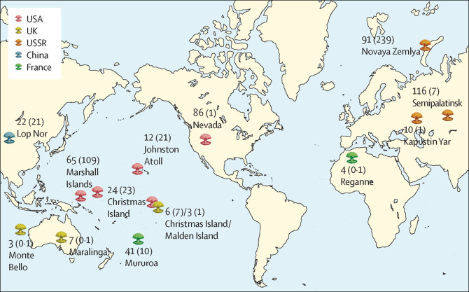
Notes:
https://www.thelancet.com/journals/lancet/article/PIIS0140-6736(15)61037-6/fulltext

Slide 16
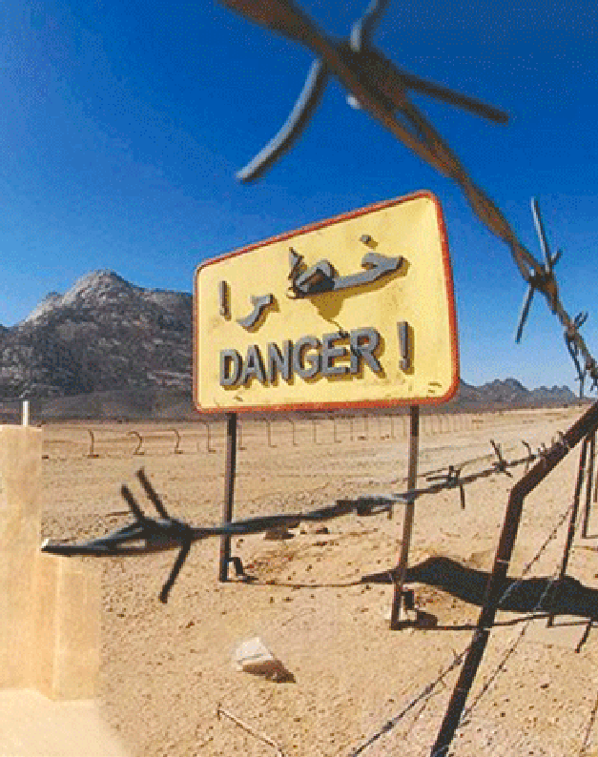
French nuclear testing in the Sahara (1960-1966)
https://www.nuclear-risks.org/en/hibakusha-worldwide/reggane.html#:~:text=The%20French%20army%20conducted%20four,cancer%2C%20infertility%20and%20genetic%20mutations.
France conducted four atmospheric tests in Hamoudia near Reggane from 1960 to 1961, and thirteen underground and five atmospheric tests in the Hoggar massif in In Ekker from 1961 to 1966, during and four years after the end of the Algerian War of Independence. As negotiated in the Evian Accords, France evacuated the sites in 1967.
Facilities and infrastructures were dismantled, and radioactive waste left on site or buried, their location still classified defence today.
Its toxic legacies are yet to be fully investigated and addressed, in terms of environmental and transgenerational public health, and recognition of and compensation for victims.
Notes:
Image source: https://www.aps.dz/en/algeria/22816-call-to-declare-13-february-national-day-of-french-nuclear-tests-victims

Slide 17
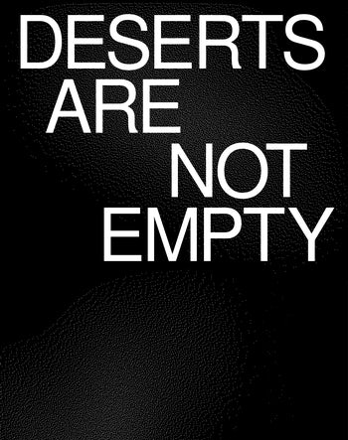
Deserts Are Not Empty
The Sahara was designated as a deserted site (‘site […] désert’) in Jules Moch’s 1959 address to the United Nations to justify the location of the trials (INA, 1960).
‘Saharianism’, as theorised by Brahim El Guabli (2022), is an imaginary that ‘entails a universalizing idea of deserts as empty and lifeless spaces, providing the conceptual justification for brutal, conscienceless, and life-threatening actions’.
‘Hourrah pour la France! Depuis ce matin, elle est plus forte et fière’ (de Gaulle, 1960)
‘Hurrah for France! Since this morning it is stronger and prouder’

Slide 18
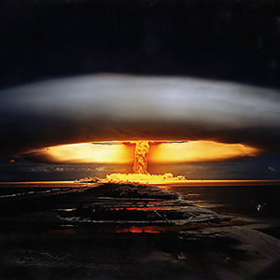
French nuclear testing in Polynesia (1966-1996)
https://www.nuclear-risks.org/en/hibakusha-worldwide/fangataufa-and-moruroa.html?L=0
In 1966, France moved their nuclear experimentation programme to Polynesia, continuing the contamination of Pacific Islands and islanders, begun by the US in 1946 in the Marshall Islands.
41–44 atmospheric and approx. 154 underground tests between 1966 and 1996
The effects remain under-estimated by the State, and victims inadequately compensated for radiation exposures.
https://moruroa-files.org/

Slide 19
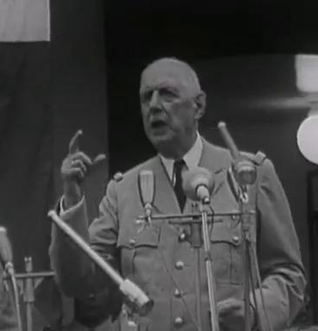
President de Gaulle (1966)
Enfin, j'ai parlé des raisons de l'avenir, votre avenir. Il peut être magnifique. Au lieu d'un territoire lointain, isolé, comme était la Polynésie française, tout vous destine à être un centre essentiel des grandes communications du grand Pacifique, entre les continents d'Amérique Latine, du Japon, de Chine, d'Australie, un centre français.
Finally, I talked about the reasons for the future, your future. It can be magnificent. Instead of a distant, isolated territory, as was French Polynesia, you are destined to be an essential centre of the great communications of the great Pacific, between the continents of Latin America, Japan, China, Australia, a French centre.

Slide 20
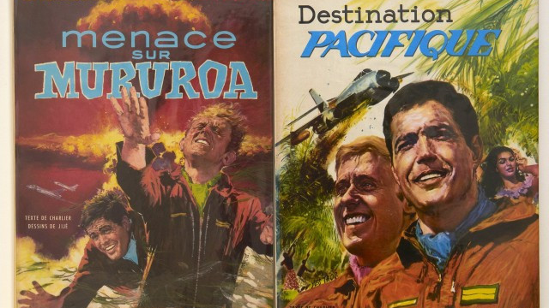
Nuclear imperialism in French popular culture

Slide 21
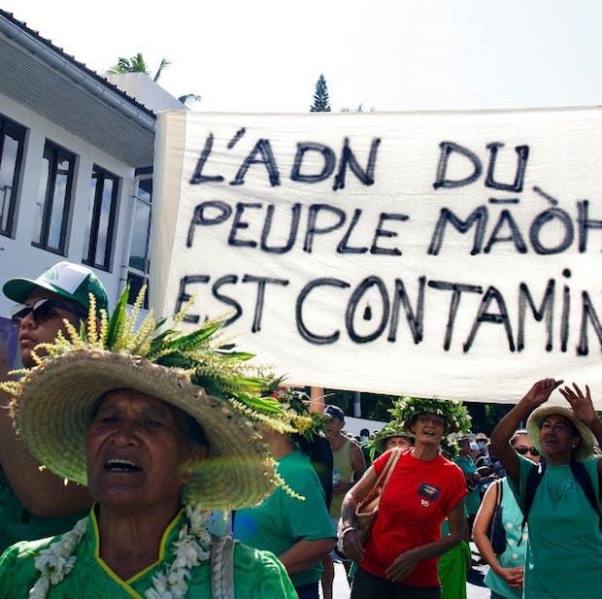
Environmental and health impacts
French presidents François Hollande and Emmanuel Macron, in their speeches in Papeʻete respectively in 2016 and 2021, called to relegate the nuclear to the past – to ‘tourner la page du nucléaire’ [close the nuclear chapter] (Hollande, 2016) and ‘écarter ces nuages’ [move these clouds aside] (Macron, 2021)
Neither issued an official apology

Slide 22
President Macron (2021)
Je pense que les choix faits à l'époque par le général de Gaulle […] étaient des choix forts, utiles à la nation et qui nous servent aujourd’hui. […] Et je pense que c'est aussi utile pour la Polynésie française.
I think that the choices made at the time by General de Gaulle […] were strong choices, useful to the nation and which serve us today. […] And I think it is also useful for French Polynesia.
On l'a fait ici parce que c'était plus loin ; on l'a fait ici parce qu'on se disait : c'est perdu au milieu du Pacifique, ça n'aura pas les mêmes conséquences.
We did it here because it was further away; we did it here because we said to ourselves: it's lost in the middle of the Pacific, it won't have the same consequences.

Slide 23
President Macron (2021)
[M]alheur aux petits, malheur aux isolés […] Et je vous le dis avec clarté : « Ici, c'est la Polynésie ! Mais ici, c'est la France ! » Et vous serez protégés.
woe to the small, woe to the isolated […] And I tell you clearly: “This is Polynesia!” But this is France! » And you will be protected.
la République est là, à vos côtés, de manière concrète pour améliorer les vies.
the Republic is there, at your side, in a concrete way to improve lives.

Slide 24
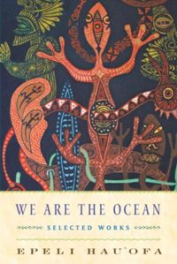
A sea of islands & the Nuclear Pacific
Imperial geopolitics that imagine the Pacific not as a ‘sea of islands’ but as ‘islands in a far sea’. The latter ‘stresses the smallness and remoteness’ from ‘centres of powers’ of the islands (Hauʻofa 1994: 152)
Nuclear tests: Christmas and Malden in the Northern Line Islands for Britain; Moruroa and Fangataufa atolls in French Polynesia; and Bikini and Enewetak atolls in the Marshall Islands for the US.
Britain also gained permission to test at Maralinga, Emu Field, and Mote Bello Island in Australia, its former settler colony (Keown 2019).

Slide 25
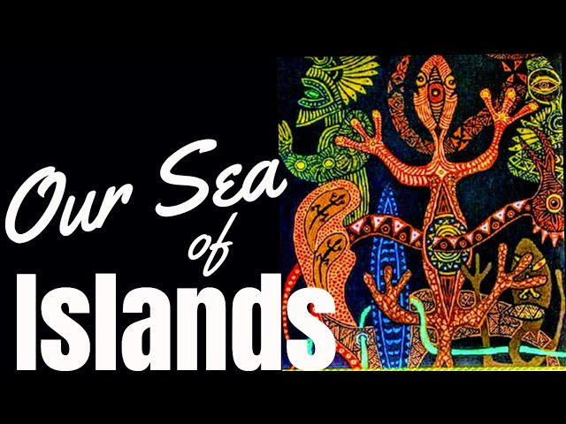
Oceania, our sea of islands
Oceania is us. We are the sea, we are the ocean, we must wake up to this ancient truth and together use it to overturn all views that aim ultimately to confine us again, physically and psychologically, in the tiny spaces that we have resisted accepting as appointed places, and from which we have recently liberated ourselves. (Hauʻofa 1994)

Slide 26
Preparation for seminar
Algerian and Polynesian anti-nuclear decolonial visual arts
See questions on Blackboard to guide your thinking
We’ll also talk about the challenges of representing environmental violence (questions of invisibility vs. hyper-visibility & slow violence)

Slide 27
Bibliography
El Guabli, Brahim, ‘Saharanism in the Sonoran’, Avery Review, 58 (2022). Available at https://averyreview.com/issues/58/saharanism-inthe-sonoran (consulted 3 July 2023).
Endres, Danielle, ‘The Rhetoric of Nuclear Colonialism: Rhetorical Exclusion of American Indian Arguments in the Yucca Mountain Nuclear Waste Siting Decision’, Communication and Critical/Cultural Studies, 6.1 (2009), https://doi.org/10.1080/14791420802632103
Hauʻofa, Epeli, ‘Our Sea of Islands’, The Contemporary Pacific, 6.1 (1994), 148-61
Hecht, Gabrielle, The Radiance of France: Nuclear Power and National Identity after World War II (Cambridge: MIT Press, 2009)
Henni, Samia (ed.), Deserts Are not Empty (New York: Columbia Books on Architecture and the City, 2022)
Hollande, François, ‘Déclaration de M. François Hollande, Président de la République, sur les efforts en faveur de la Polynésie française, à Tahiti Papeete le 22 février 2016’, 2016. Available at https://www.vie-publique.fr/discours/198041-declaration-de-m-francois-hollande-president-de-la-republique-sur-les (consulted 3 July 2023)
INA, ‘Défense des essais nucléaires français : Jules Moch à l’ONU’, 1960. Available at https://mediaclip.ina.fr/fr/i19021262-defense-des-essais-nucleaires-francais-jules-moch-a-l-onu.html (consulted 3 July 2023).

Slide 28
Bibliography
Jarvis, Jill, ‘Radiant Matter: Technologies of Light and the Long Shadow of French Nuclear Imperialism in the Algerian Sahara’, Representations 160.1 (2022), 54-89.
Keown, Michelle, ‘Waves of Destruction: Nuclear Imperialism and Antinuclear Protest in the Indigenous Literatures of the Pacific’, Journal of Postcolonial Writing, 54.5 (2018), 585-600
‘Le Général de Gaulle : hourra pour la France !’, Le Monde, 15 February 1960. Available at https://www.lemonde.fr/archives/article/1960/02/15/le-general-de-gaulle-hourra-pour-la-france_2099729_1819218.html (consulted 3 July 2023).
Macron, Emmanuel, ‘Discours du Président Emmanuel Macron depuis Papeete’, 2021. Available at https://www.elysee.fr/emmanuel-macron/2021/07/28/discours-du-president-emmanuel-macron-depuis-papeete (consulted 3 July 2023)
Maurer, Anaïs and Rebecca H. Hogue, ‘Special Forum Introduction: Transnational Nuclear Imperialisms’, Journal of Transnational American Studies, 11: 2 (2020), 153–71
Nixon, Rob, Slow Violence and the Environmentalism of the Poor (Cambridge: Harvard University Press, 2011)

