Slide 1
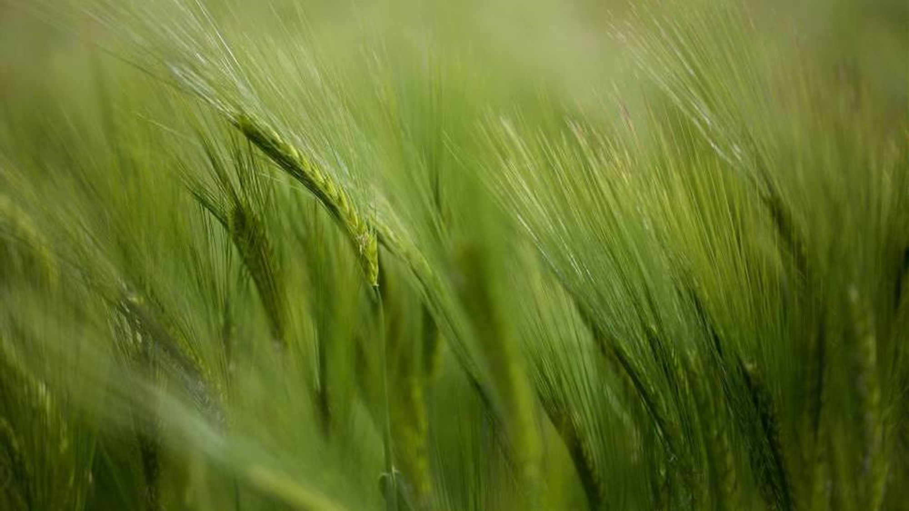
Environmental crisis, awareness-raising and activism through contemporary French poetry part 1
Dr Marion Krauthaker
Lecturer in French
Marion.Krauthaker@universityofgalway.ie

Slide 2
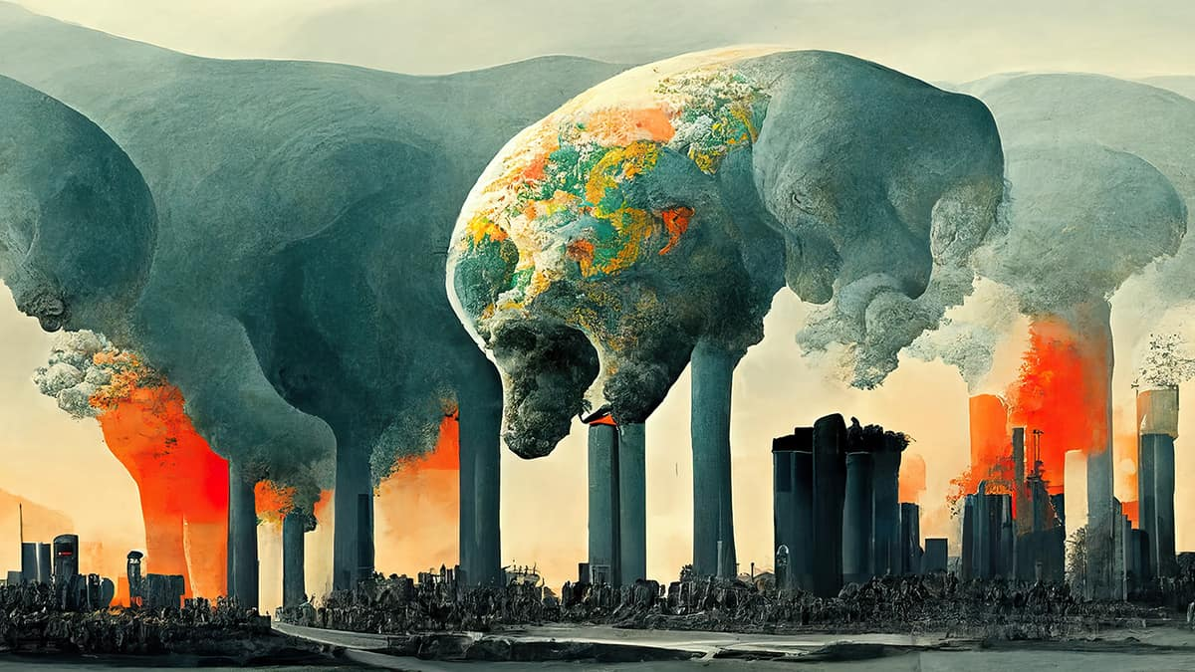
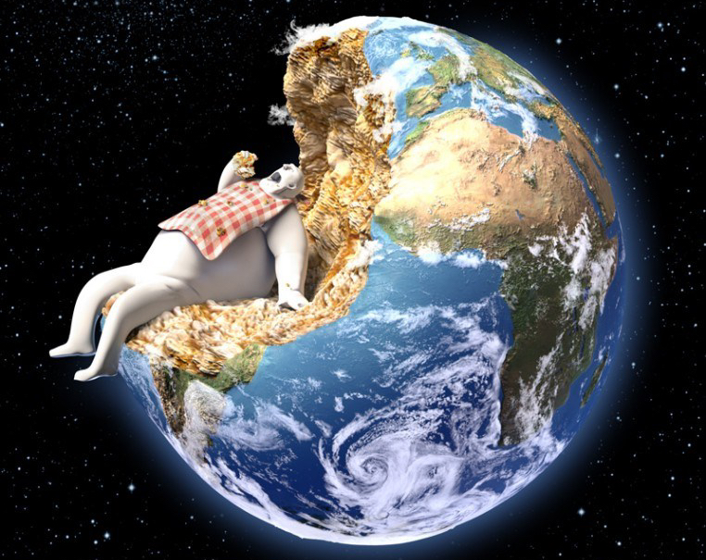
Commentators, from student activist Greta Thunberg to United Nations Secretary General António Guterres, are now describing the current global situation as an environmental emergency or climate crisis.
A contrast with previous terms like 'climate change' or 'environmental change’.
The climate crisis has led to complex debates and has influenced the literary production of many countries.

Slide 3
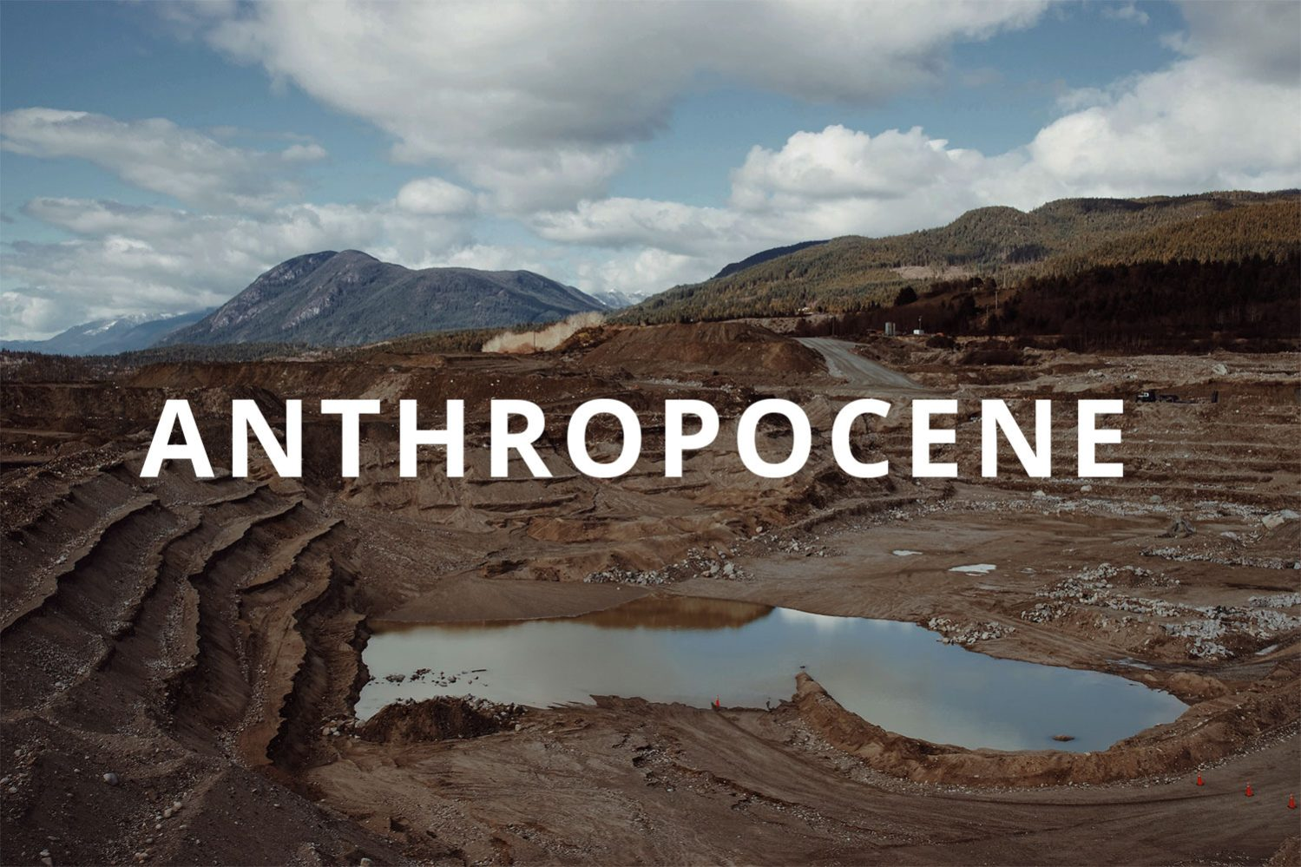
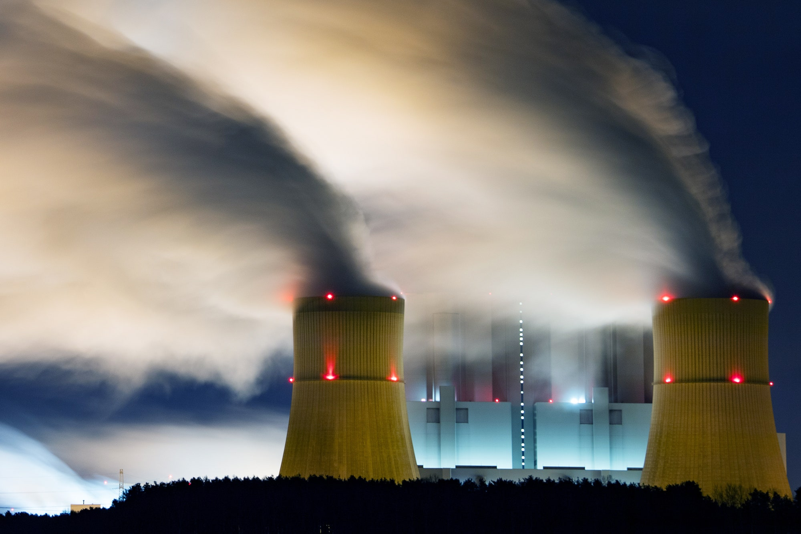
Paul Crutzen has suggested that as human activities define the current geological epoch, it should be named the Anthropocene (2000).
Donna Haraway critiques the notion that all humans are equally responsible for the processes leading to the current environmental crisis and proposes 'Capitalocene' or 'Plantationocene' as more accurate terms (2015).
Marisol de la Cadena introduces the concept of the 'anthropo-not-seen’ (2015) to emphasize the experiences of peoples whose ontologies never separated humans from nature, but who are now being compelled into such divisions.

Slide 4

Since the 18th- 19th centuries, the human/nature connection has been present in poetry, for instance in Romanticism or Symbolism.
Let’s read and discuss
    Victor Hugo (1802-1885), “Soleils couchants” (1828).
    Arthur Rimbaud (1854-1891), “Aube” (1873).
Since the 19th century, poetry has served as a powerful political and social expression tool.
Considering the ecological crisis in the 21st century (and which started in the 20th), French poets are rediscovering this connection.

Slide 5
Without reaching the level of ‘ecological poetry’ and ‘eco-poetry’ yet, a poetical revolution is stirring both French ecological and French literary communities, prompting them to engage with each other and with the climate crisis.
This shift has challenged poetry, language and our relationship with the world.
Is French poetry a place of ecological resistance, or is it becoming one?

Slide 6


Far from political discourses on 'sustainable development’ and 'green transition’, 20th and 21st century some French poets are taking the ecological question head-on in a subversive and radical way.
They show that literature is not a closed bubble, but rather a space that engages with the outside world and mixes, for the first time, science and poetry.
Philosopher Michel Deguy (1930-2022), La Fin dans le monde (2009): the poet must be 'a seer, a light that alerts us.’
Writer Jean-Luc Pinson (1947), Pastoral: de la poésie comme écologie: the climate crisis is 'an insurmountable horizon,’ and in this context, the poet has a role to play. 'We write poetry to live. To make existence and the world more habitable’.

Slide 7
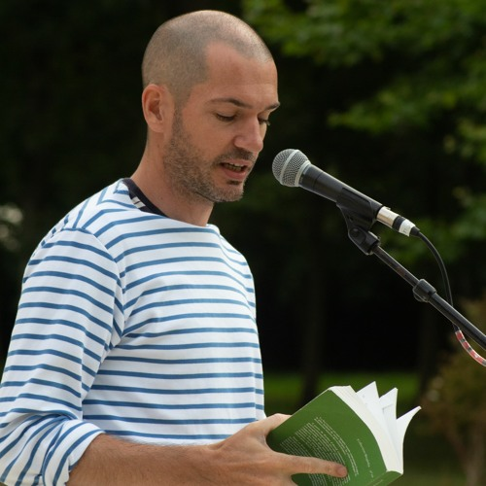
Pierre Vinclair in Reporterre (online media): ‘Poetry builds potholes on the highway of the world's devastation’. Poetry will not save the planet, but if everyone did nothing but read or write poetry, the planet would be saved. ‘Poetry is the absolute act of deceleration. You can spend two hours with a notebook deciphering a poem, and it doesn't emit CO2, unlike Netflix; it slows down time.’

Slide 8

Dissemination of ecologically oriented poetry:
Collection Biophilia, by Corti
New poetry collections focussed on the environment by Wildproject or Cambourakis.
Magazines: Catastrophe, Les Haleurs or Po&sie.
Des ecology and poetry festivals are growing and organise writing workshops.

Slide 9
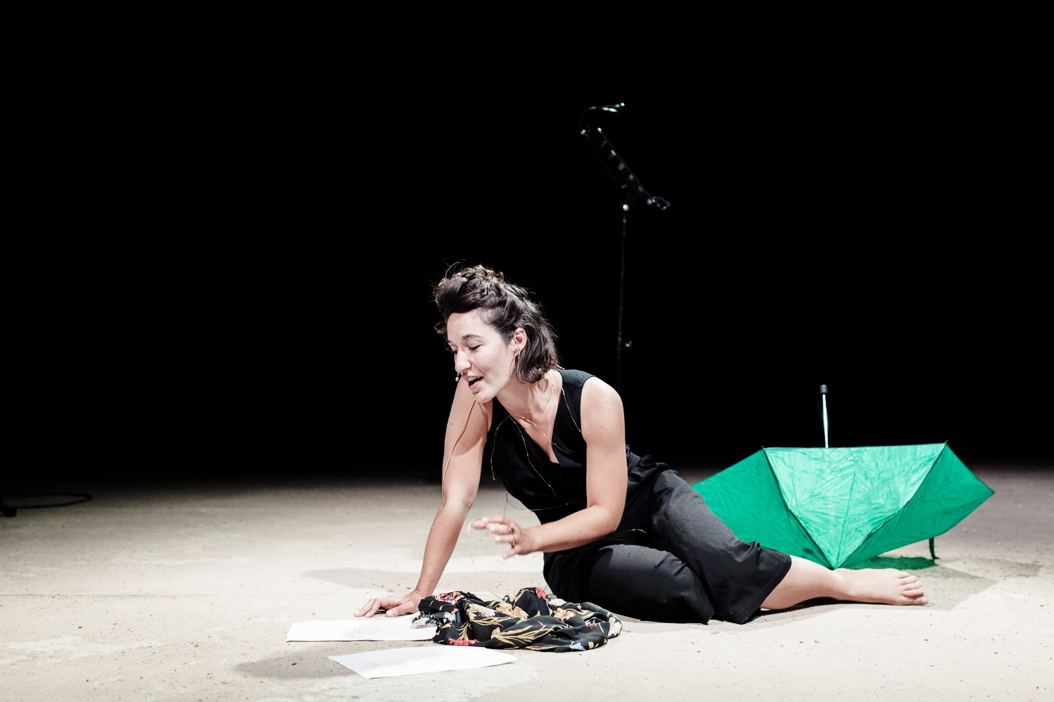
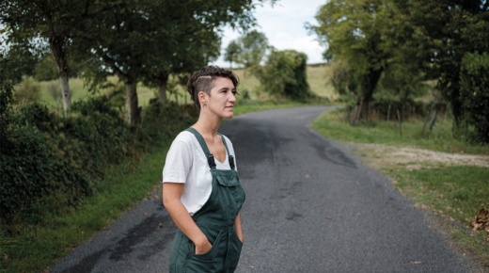
Hortense Raynal, Bouche fumier (2023), uses language as she uses the earth. She sketches out a ‘compost poetry’, with her feet in the clay: ‘Language is beaten flesh, a body returning to the earth to nourish it’: https://youtu.be/tzCpF0IVmcg?si=6mMrr_zFXWYNYY-j

Slide 10
In Bouche-fumier, Raynal interrogates the essence of poetry with an organic and decomposed language: poetic creation is like "fertilizing the soils of our existences" with words. This process includes a series of physical acts such as getting dirty, digging, and even rummaging through waste, thus reflecting the chaotic nature of poetry.
Bouche-fumier is an interior monologue in a lively, disjointed prose style that features streams of thought and associations of ideas: a fluid poetic form that often challenges conventional syntax, embracing the bizarre and the queer.
Ultimately, Raynal asserts that poetry is not a means of building a home, but rather of destroying and disrupting domesticity and returning to the earth. For her, poetry can be a powerful force of social creation and destruction, questioning norms and crossing boundaries, and returning to nature, to the soil.

Slide 11

Let’s read and discuss:
Sébastien Fevry, Brefs Déluges, 2020.

Slide 12
Brefs Déluges: a violent storm crossing the Atlantic.
Through the image of a powerful wind, the poem describes a chaotic landscape where owls (representing order, wisdom, and life as we know it) with yellow eyes are perched in a cloud.
The poem plays on the contrast between the tranquility of the owls in the cloud and the disorder below, highlighting the fragility of human life in the face of the forces of nature. It raises questions about the relationship between humans and natural elements, as well as how we perceive and navigate the storms of our existence.
It serves as a metaphor for the effects of climate change and how it alters our environment: increasingly frequent storms, the vulnerability of ships, a changing nature, and the detachment of humanity (a lack of awareness).

Slide 13
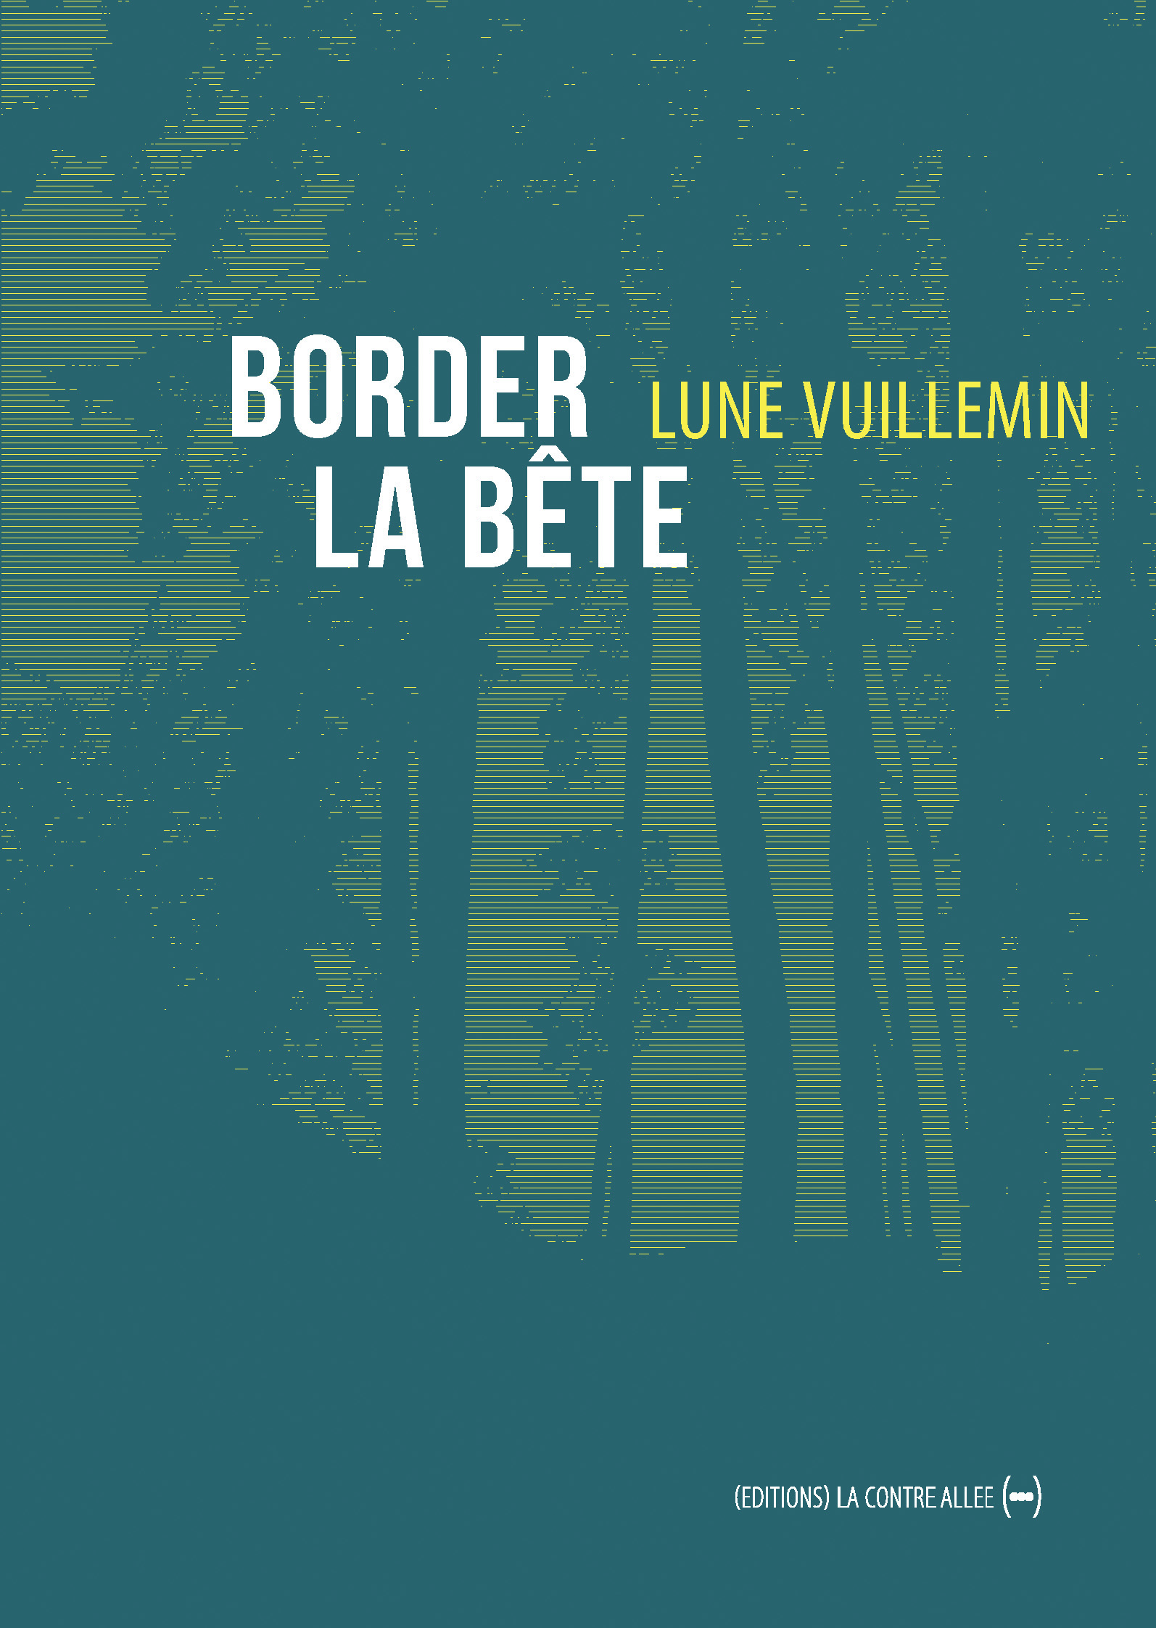
Read Lune Villemin ‘s Border la bête (2024) and discuss what is ecopoetical about this poem?

Slide 14

Daisy Sainsbury, Contemporary French Poetry: Towards a Minor Poetics, Research Monographs in French Studies, 65, 2022.
How to read ecopoetry?
In Gilles Deleuze and Félix Guattari’s definition of ‘minor literature’ (Kafka: pour une littérature mineure, 1975): in contrast to ‘major’ literature, it ‘disorder[s] language, rendering it strange, agrammatical and foreign’ (pp. 1, 32, 2).
Some writers challenge hegemonic literary forms and traditions: the difference-seeking, experimental dimension of modern poetry qualifies it as ‘minor literature’.
Close readings of texts and their use of language can reveal the similarities with minor literature in their relationships to power structures.

Slide 15
Daisy Sainsbury, Contemporary French Poetry: Towards a Minor Poetics, Research Monographs in French Studies, 65, 2022.
There is a broader tendency towards multilingual experimentation in the contemporary field of French poetry.
‘Minor literature will appear wherever a writer resists the illusory monolingualism of the major language’ (p.24).
Minority’ manifests as an aesthetic or compositional choice.

Slide 16
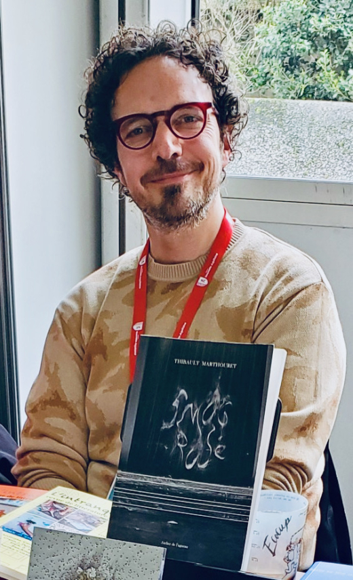
Let’s read ‘L’annonce’ by Thibault Mathouret, Smog Rosé (2021)

Slide 17
‘L’annonce’ : describes the effects of summer heat on individuals and the environment while questioning the collective perception of climate change.

Slide 18
Heat as a Media Event
The poem begins with a reference to a television bulletin announcing oppressive heat. This introduction highlights how the media treats climatic phenomena, emphasizing the distance between information and personal experience. The heat is presented as both a mundane and alarming event.

Slide 19
Superficial Beauty and Artificiality:
The "beautiful people" who appear in the heat are described wearing light clothing and with shiny hair, suggesting an idealized image of summer. However, their existence is ephemeral and tied to favorable or unfavorable weather conditions. This evokes the superficiality of aesthetic norms in a changing climate. This beauty contrasts with the condition of those who endure the heat in a heavier and more unpleasant manner, described as prisoners of the climate.

Slide 20
The Accumulation of Temperatures:
The repetition of the idea that the heat is "beating its own record" emphasizes the urgency of the climatic situation. The mercury, a symbol of temperature, becomes omnipresent, creating a suffocating atmosphere.
An Overwhelming Summer:
The entry into summer is described both physically and symbolically, where summer seems to permeate every aspect of the human being. The phrase "we are heavily entering summer" evokes a sense of weight and difficulty. Sensory descriptions, such as the "burnt" light and the sound of "sizzling," reinforce the immersion in this summer experience, creating a tangible and oppressive atmosphere.

Slide 21
Corporeal Metaphors and Pollution:
The air laden with "indelible particles" and the description of heat that "burns" suggest pollution and its harmful effects. The image of "embryos putting on makeup with soot" illustrates how pollution affects even the most innocent.
Interconnection Between Humans and the Environment:
The poem explores the intimate relationship between individuals and their environment. Heat and pollution are not just external elements; they seep into bodies and minds, transforming them.

Slide 22
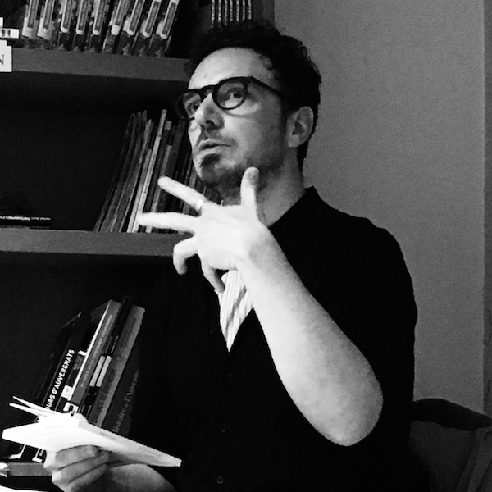
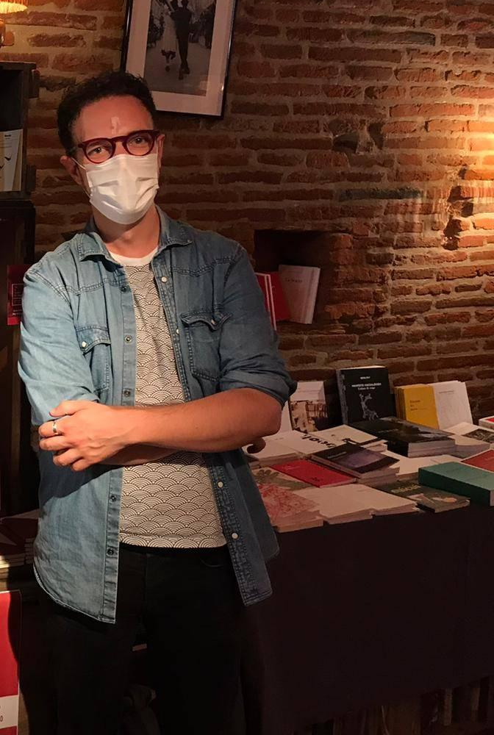
Read ‘Lourds’ by Thibault Mathouret, Smog Rosé and discuss the link between form and content in this poem.
Again, along Sainsbury’s theory,
what characteristics would make it Minor Literature?

