Slide 1

Environmental crisis, awareness-raising and activism through contemporary French poetry part 2
Dr Marion Krauthaker
Lecturer in French
Marion.Krauthaker@universityofgalway.ie

Slide 2

Daisy Sainsbury, Contemporary French Poetry: Towards a Minor Poetics, Research Monographs in French Studies, 65, 2022.
Reading ecopoetry as minor literature?
Deleuze and Guattari’s definition of ‘minor literature’ (Kafka: pour une littérature mineure, 1975): in contrast to ‘major’ literature, it ‘disorder[s] language, rendering it strange, agrammatical and foreign’ (pp. 1, 32, 2).
Sainsbury posits that:
    the difference-seeking, experimental dimension of modern poetry qualifies it as ‘minor literature’.
    close readings of texts (form, use of language and content) can reveal the similarities with minor literature in their relationships to power structures.
    ‘Minor literature will appear wherever a writer resists the illusory monolingualism of the major language’ (p.24).

Slide 3

In light of the conversation with poet Thibault Marthouret and the material covered in our first session, carry out a detailed analysis of the following poems (1 poem per group) and present to the class (theme, message, form and reading of some images used):
  ‘Prise d’assaut’ / ‘Besieged’
  ‘La montée des eaux’ / ‘The Rise of the Waters’
  ‘Comme si’ / ‘As If’
  Remember to focus specifically on ecopoetical features and characteristics that may make this poems minor literature.

Slide 4

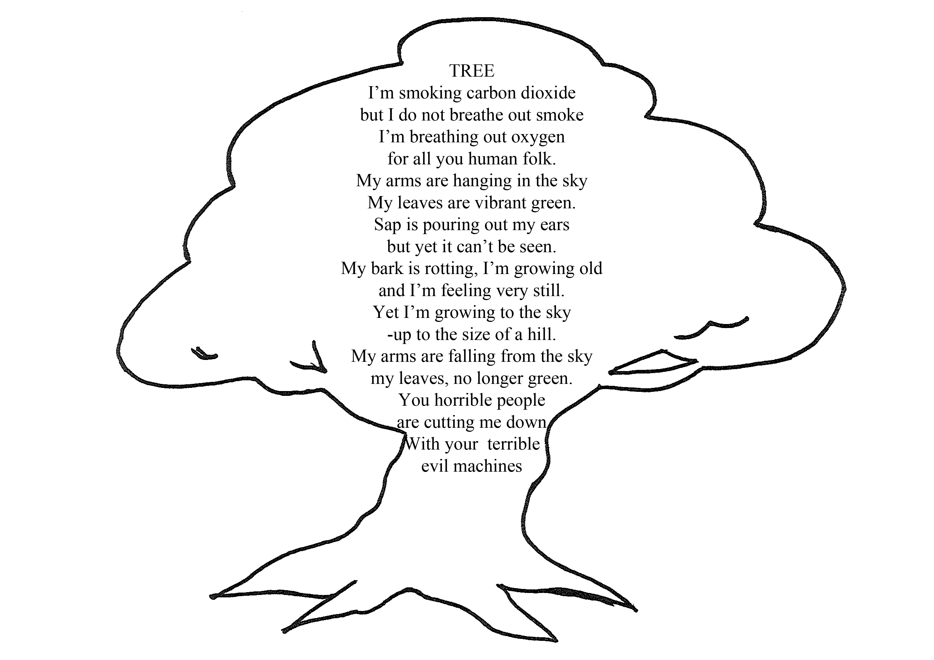
In the 19th century, in addition to dealing with nature, the literary imagery of numerous French writers became a space for exploring the urban universe (Charles Baudelaire’s work on Paris such as Le Spleen de Paris, Les Petits poèmes en prose).
Texts reflect the industrialisation and urbanisation of France/French society as well as the ecological behaviour of the French people.
Literature can:
  become an ecological counter-discourse
  serves to support the discourse on the environment through the literary aesthetic literary texts
  paradoxically deconstruct or sublimate the environment.

Slide 5
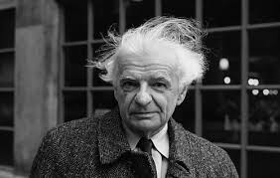

From the 2000s onward, ecocriticism and discourse on the environment in literature began to develop in France. In contemporary poetry, emerges a new/modern reflection on the fusion between beings and nature.
In the poetry of Yves Bonnefoy (1923-2016) : the personification of the earth demonstrates the marriage between man and the world.
Bonnefoy moves closer to nature and calls this world "Douve," (a feminine and maternal Earth): anthropomorphism of Douve (both rebellious and submissive to human)
He also develops a reification of language and plays with codes.

Slide 6
Let’s read and discuss poems by Yves Bonnefoy:
    ‘Vrai Corps’ / True Body
    ‘Oui, moi les pierres du soir’ / Yes, I, the stones of the evening

Slide 7
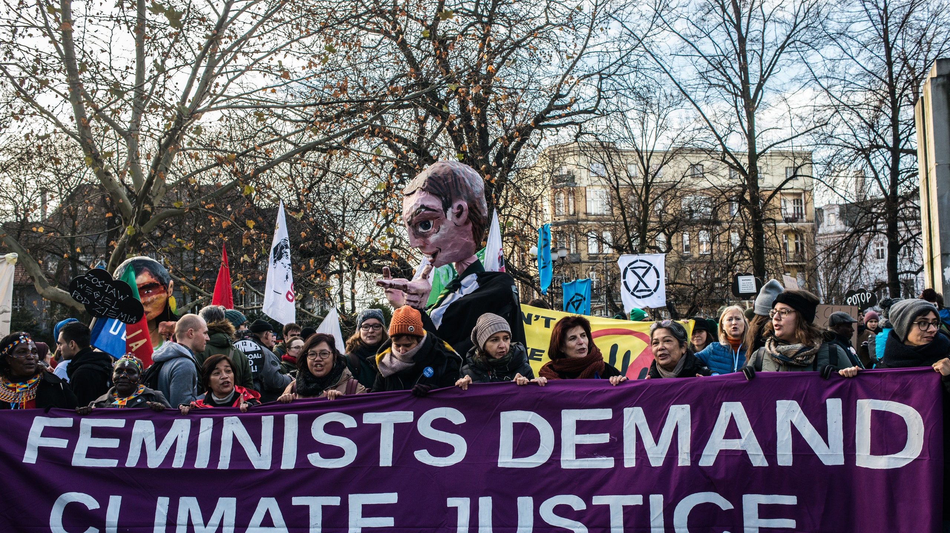

Current ecological debates do not really cover the question of how all these environmental processes are gendered (Großman and Haug 2018).
Questions surrounding a critical rethinking of the nature/culture divide resonate with the problematics of gender and essentialism: this makes joint questions about gender and the environment highly pertinent.
People relate to their environments in different ways, develop different environmental knowledge and, in some societies, gender determines access to and control over natural resources (Großman and Haug 2018) and decision-making processes (Shiva 2006).
Changes being caused by the global environmental crises affect and transform local livelihoods in which roles are typically defined according to gender.
Environmental change often leads to changes of economic systems and social structures impacting on gender relations, gender identities, roles and work activities, gendered health impacts and the exclusion of certain people from multiple economic and social systems (Rao et al 2019).

Slide 8
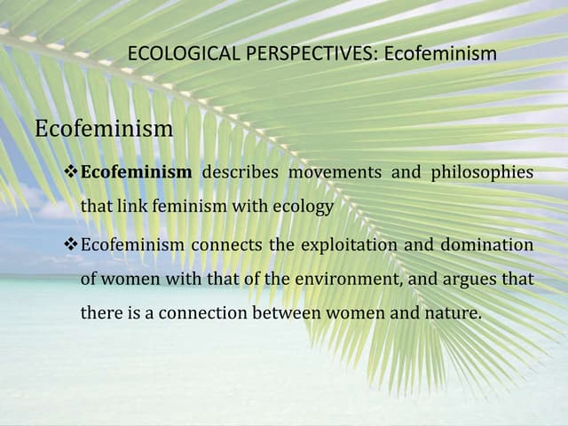

Ecofeminism:
To apprehend the origins and applications of ecofeminism
To understand ecofeminism as an intellectual and activist movement
To grasp the relation between gender and environment
To critique culture through ecofeminist lens (e.g. through poetry).

Slide 9
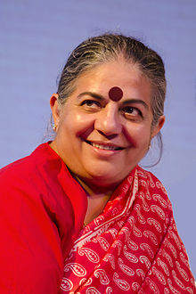



Vandana Shiva Shiva (1952) traces women’s involvement with the environmental movement to the Chipko movement, when three hundred years ago women in Rajasthan sacrificed their lives to protect sacred khejri trees.
Shiva and other ecofeminist scholars draw links between social inequalities and environmental degradation, arguing that both nature and women have been subjected to oppression by a patriarchal system that devalues both (Biehl 1991; Mies andShiva 1991).
Shiva claims that the link between women and the environment is a ‘natural’ one, which she refers to at the ‘feminine principles (known in Hindi as shakti or prakriti) (Shiva, 1988, xvii).
Other ecofeminists supported and developed this approach placing women as close to nature socially, culturally, and biologically (Carol Christ 1990, Starhawk 1990).

Slide 10


‘Essentialist views’ such as have been strongly criticized
Bina Agarwal (1998) and Meera Nanda (1991) argue that Shiva romanticizes women’s experiences and their relationship with the environment, which tends to reinforce gendered stereotypes (women more restricted because they are predetermined).
Kings (2017) also critiques Shiva’s approach to feminism as a generalization of women’s experiences, taking research from rural communities in the northwest of India and applying it to women in the Global South and the world
MacGregor, Sherilyn. 2010. “‘Gender and Climate Change’: From Impacts to Discourses,” Journal of the Indian Ocean Region 6(2): 223–38.

Slide 11
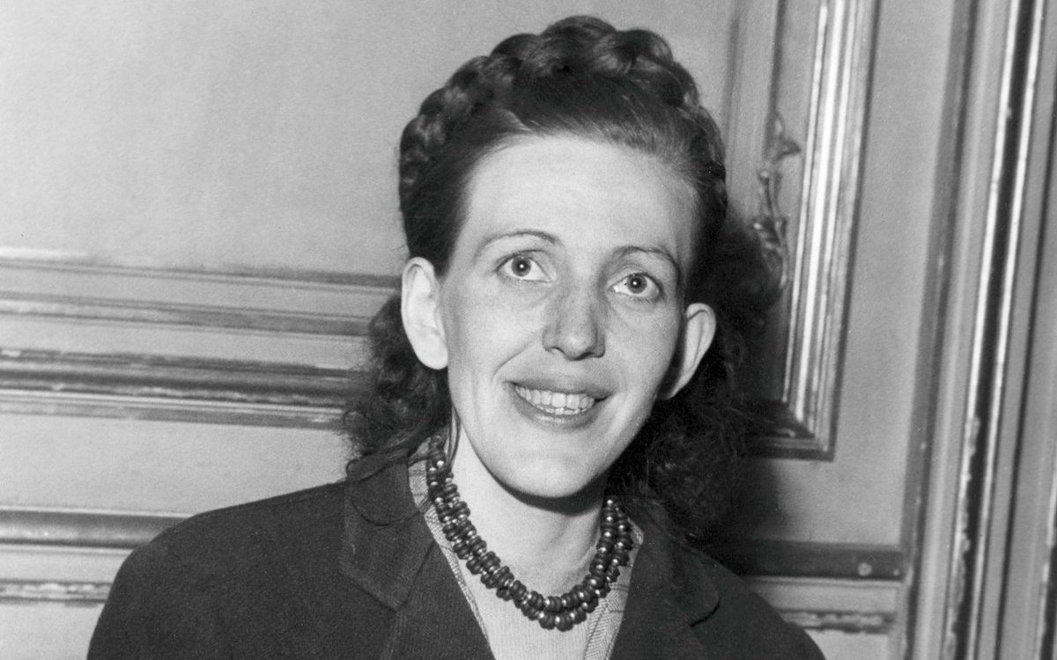
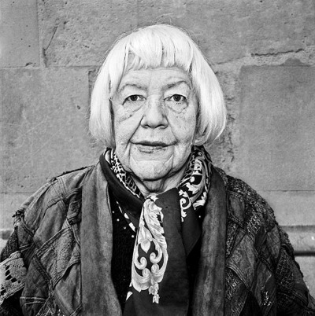
Françoise d'Eaubonn, the French feminist behind the theory of ecofeminism: https://www.versobooks.com/blogs/news/5289-meet-the-french-feminist-behind-the-theory-of-ecofeminism?srsltid=AfmBOopYZTub-7yeFPA3QF1XLTiyOvSTdfE2b5jFVkBZk2u_SzavK5Ji

Slide 12

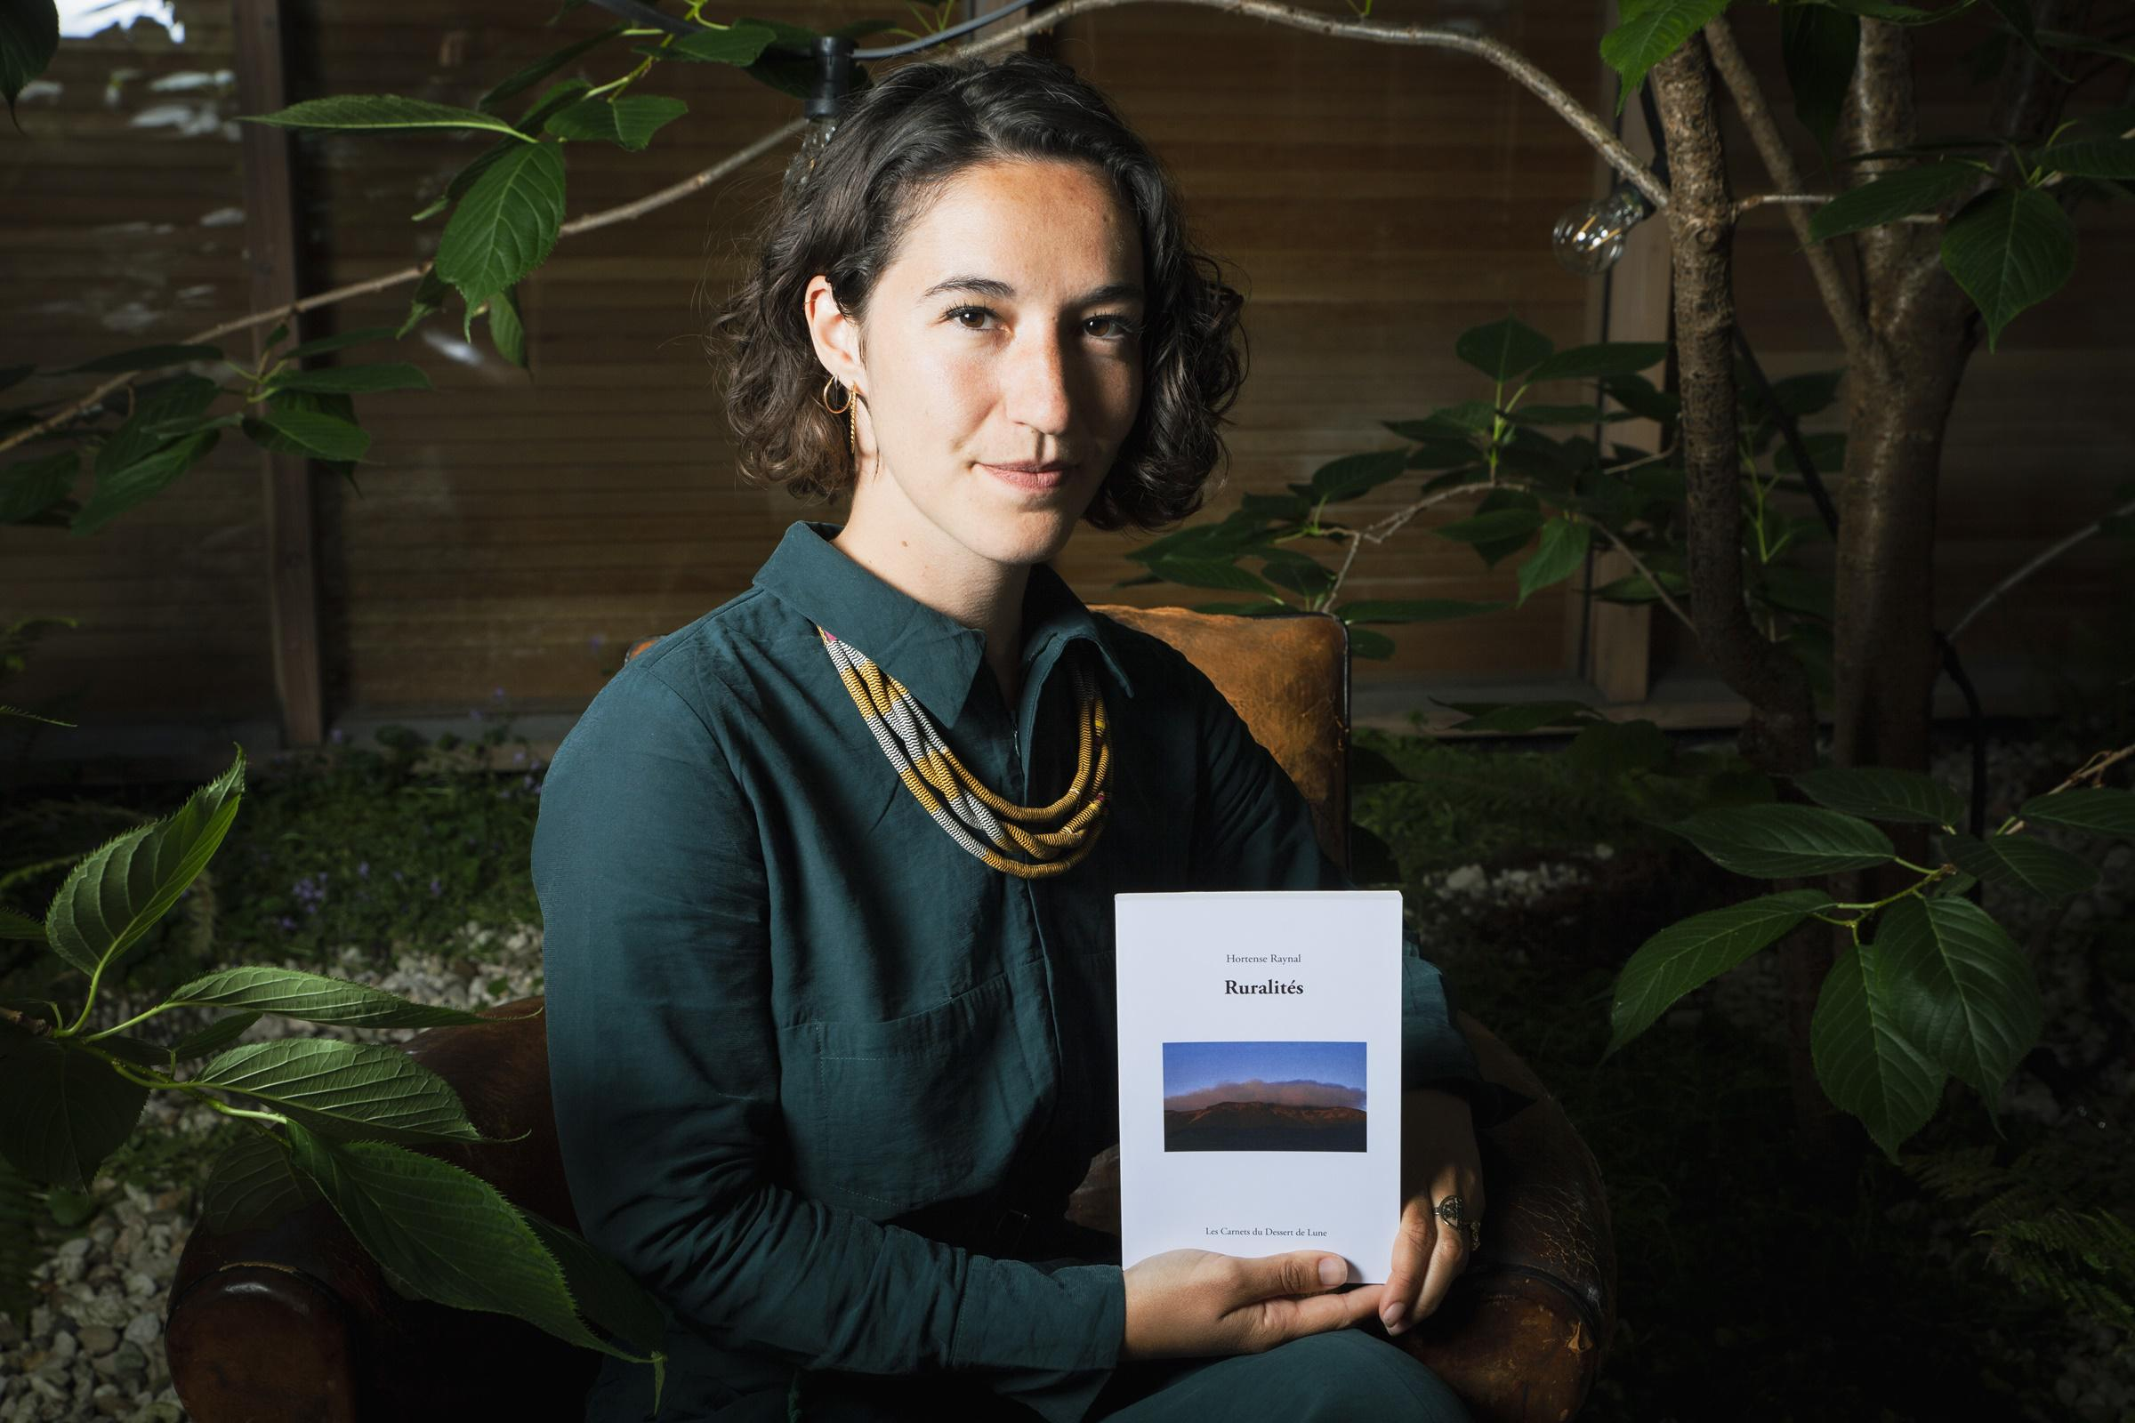
Let’s read and discuss ‘Nous sommes des marécages’ - Hortense Raynal (2023):
What characteristics would make it Minor Literature?
What is ecofeminist about this poem?

